Slide 1

Control Statements Java - The Complete Reference Herbert Schildt Chapter 5

Slide 2
For-Each Loop
(Enhanced for Loop)

Slide 3
Introduction to the for-each Loop
Introduced in Java 5 to simplify iterating over arrays and collections.
Also called the enhanced for loop. The type of each value must be compatible with the type of expression.
Eliminates the need for index variables and bounds checking.
Syntax:
for ( dataType variable : arrayOrCollection ) {
// code using 'variable’
}

Slide 4
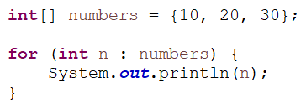
Example of for-each Loop

Slide 5
Advantages of the for-each Loop
Key Benefits
Cleaner and more readable syntax.
Avoids index-out-of-bound errors.
Best suited for traversing arrays and collections when no modification to the structure is needed.
Ideal for read-only access.
Limitation
Cannot modify the array’s structure (e.g., resizing).
Cannot access element indices directly.

Slide 6
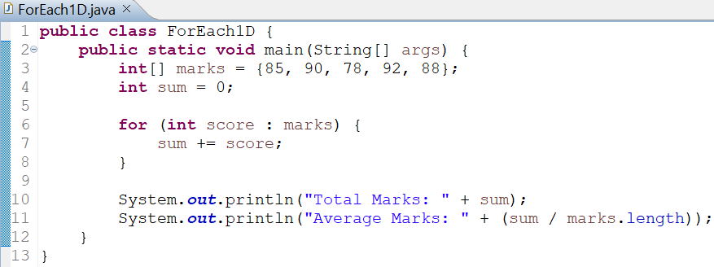
Using for-each with One-Dimensional Arrays
Example 1: Summing elements in a 1D array
score temporarily holds each element of marks.
No index used; iteration is automatic.

Slide 7
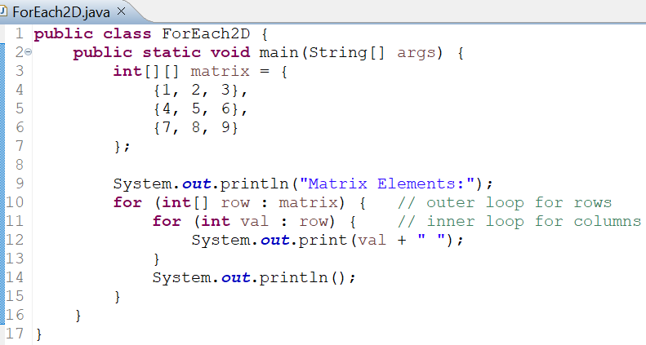
Using for-each with Two-Dimensional Arrays
Example 2: Displaying elements of a 2D array
Outer for-each loop → iterates through each row (1D array).
Inner for-each loop → iterates through elements of each row.

Slide 8
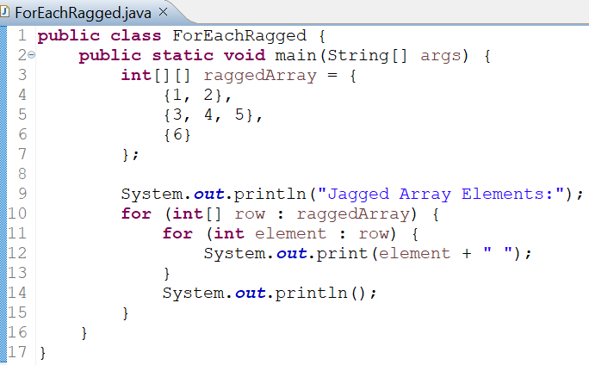
Using for-each with Ragged (Jagged) Arrays
Example 3: Iterating over a ragged array
Each row can have different lengths.
The for-each loop adapts automatically to row size.
No need for row.length checks.

Slide 9
Summary and Best Practices
When to Use for-each
Traversing arrays or collections for reading or computation.
Simplifying nested loops (especially for 2D/3D or ragged arrays).
When index access is not required.
When not to Use
When you need to modify specific elements based on the index.
When iterating multiple arrays in parallel.
When you need to know the current element’s index.

